Slide 1

Waste and Recycling framework

Slide 2
Introduction
PURPOSE
The framework ensures that the correct disposable packaging is used at the NFF so that it can be composted, recycled, upcycled or repurposed locally to avoid ending up as waste in landfill.
PRODUCTS
We understand that as vendors you may wish to present your food in a particular way, so we have tried to feature a wide variety of options that meet our sustainability criteria and will hopefully meet your packaging requirements.
PLAN
Planning your packaging well in advance before arriving ensure that you can trade without delay. Below are some lists and we can discuss with you whether your current packaging is accepted or help you source packaging if needed.

Slide 3
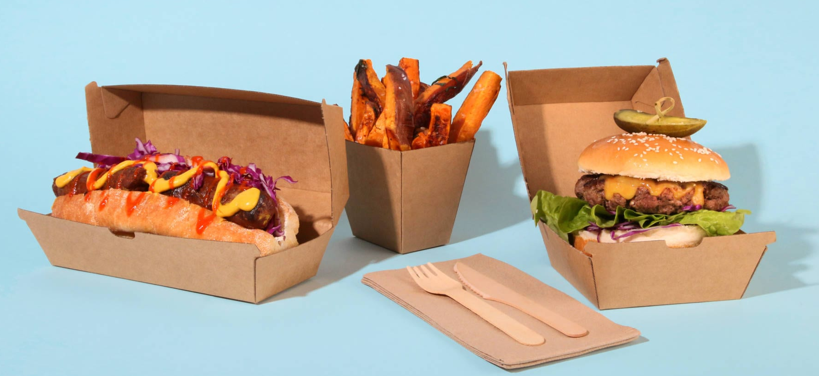
Approved Packaging

Slide 4
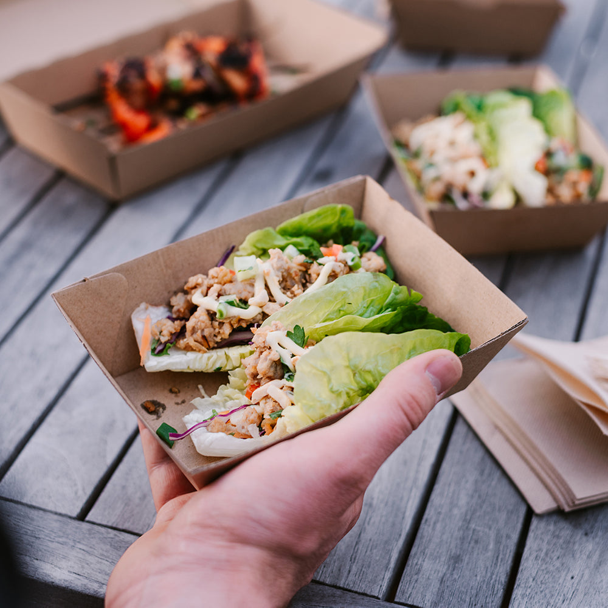
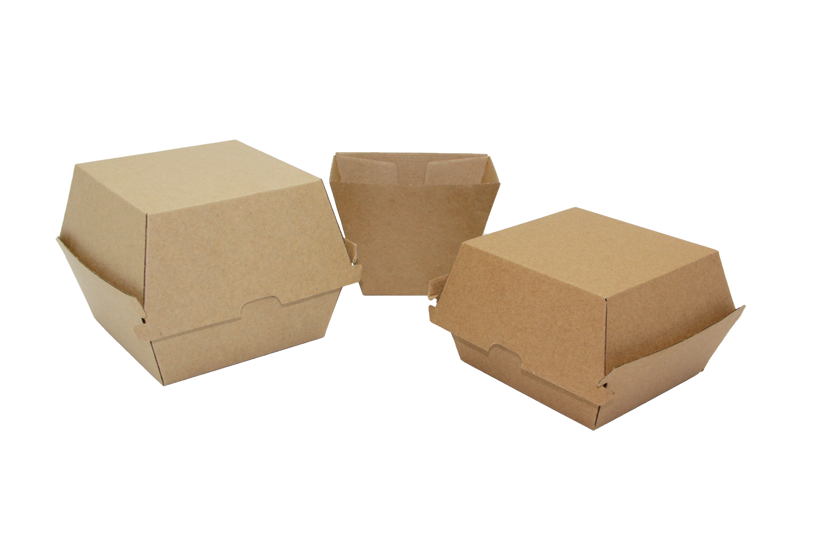
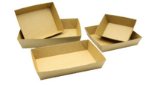
Approved Packaging | Kraft Range
Serving Products
Clamshells
Burger Boxes
Chip Cups
Pizza, Dinner and Snack Boxes
Carry Boxes
Open Trays (including Hot dog boats)
*All Kraft Packaging must be uncoated and have no PLA or plastic linings.

Slide 5
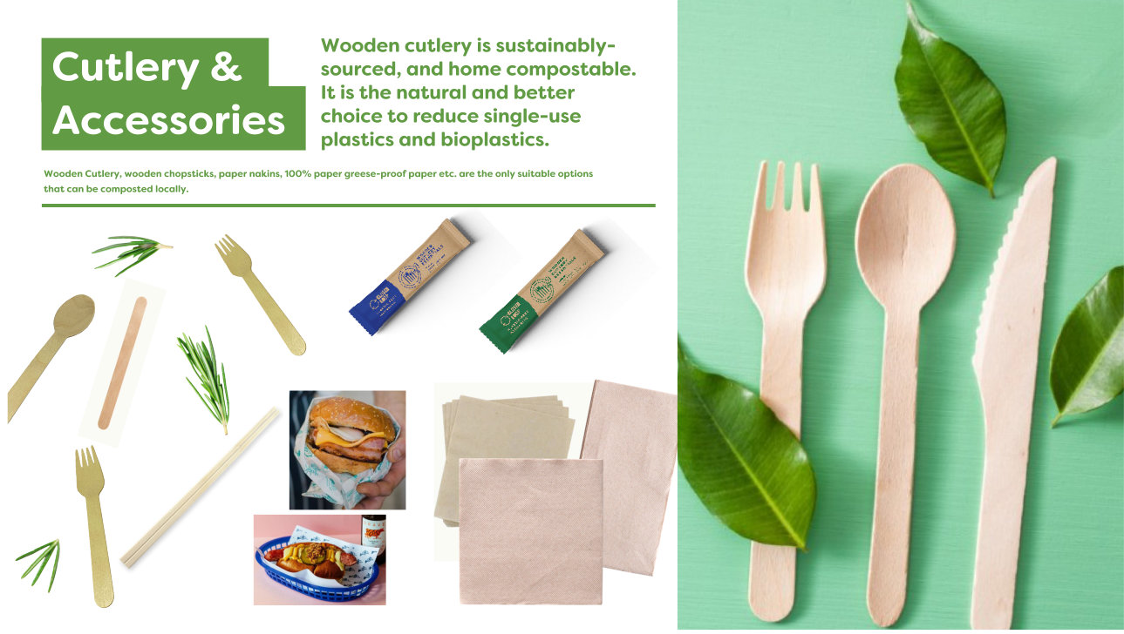

Slide 6
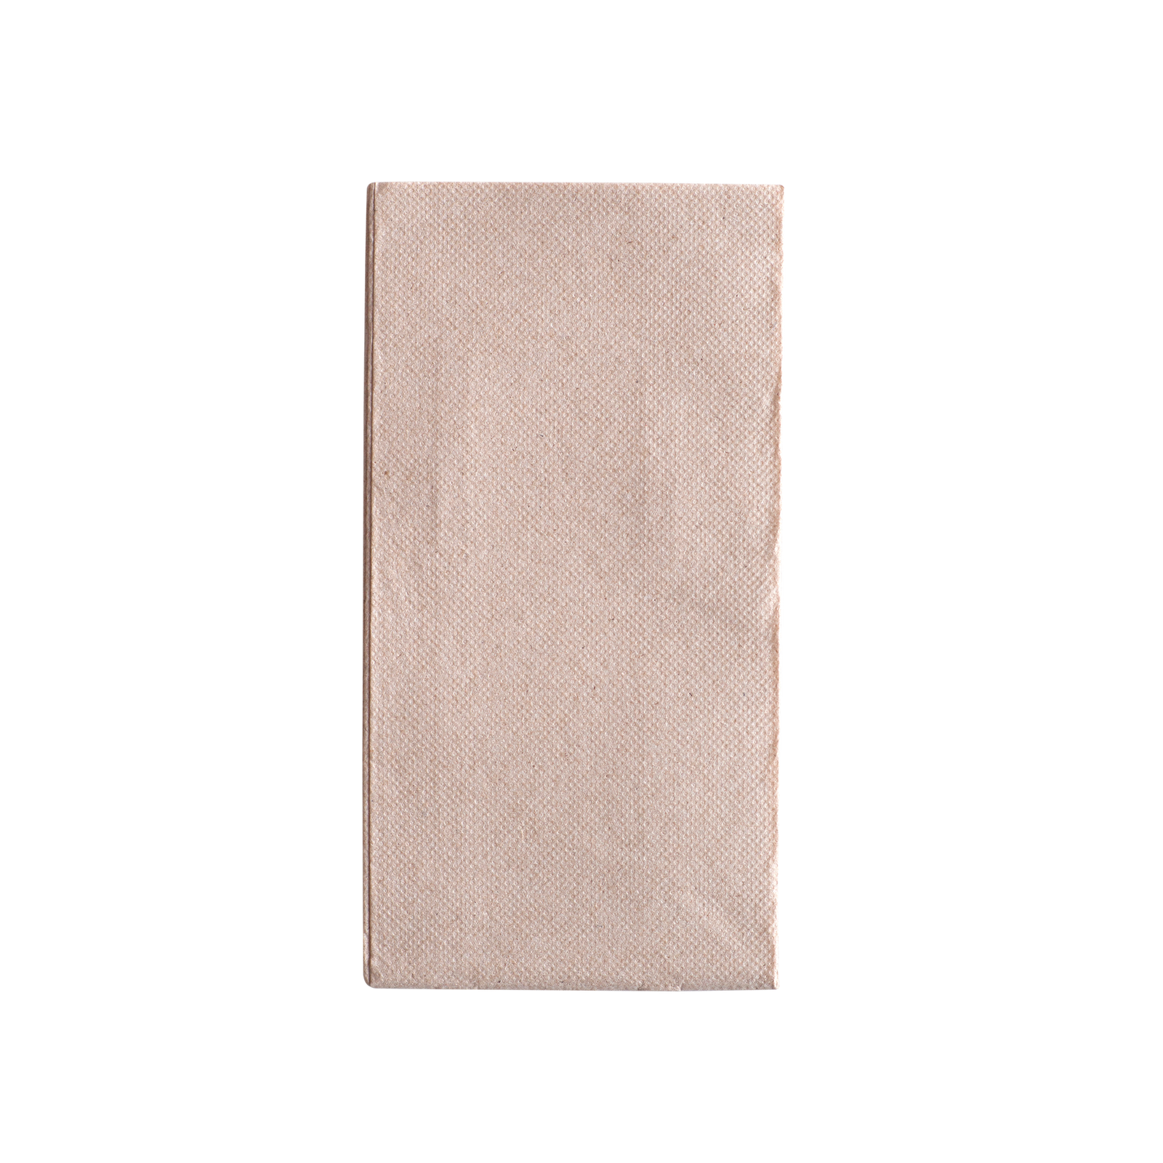
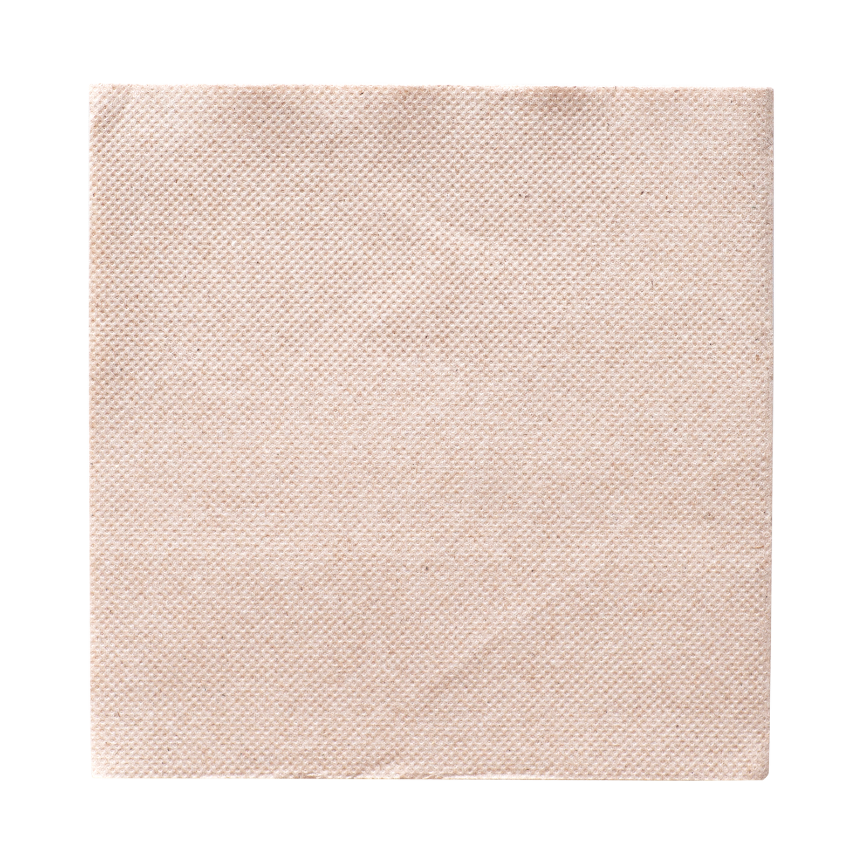
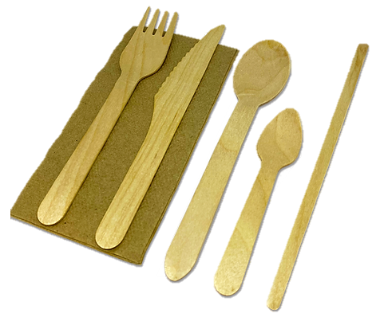
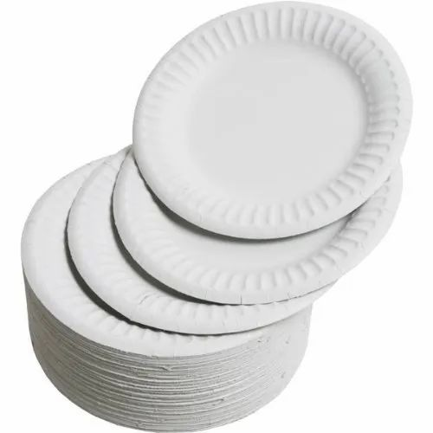

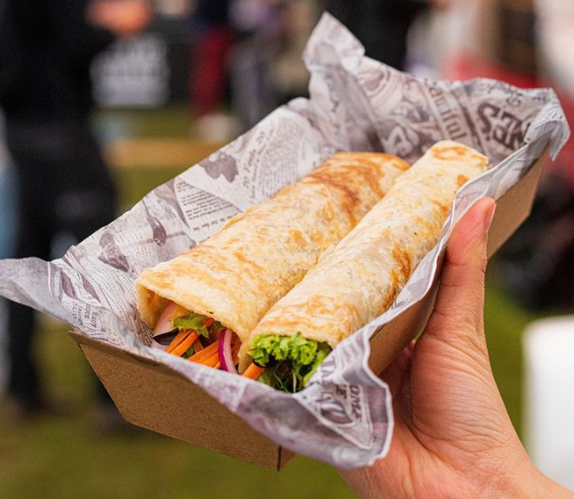
Approved Packaging | Cutlery & Accessories
Paper Plates and serving containers(uncoated)
100% Wooden Cutlery (uncoated)
100% Paper or Greaseproof Paper
Paper Napkins
Cardboard Discs (for serving Pizza slices)

Slide 7
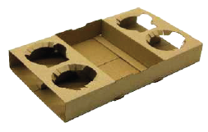
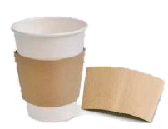
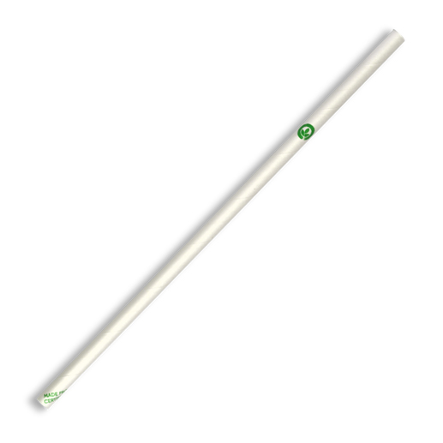
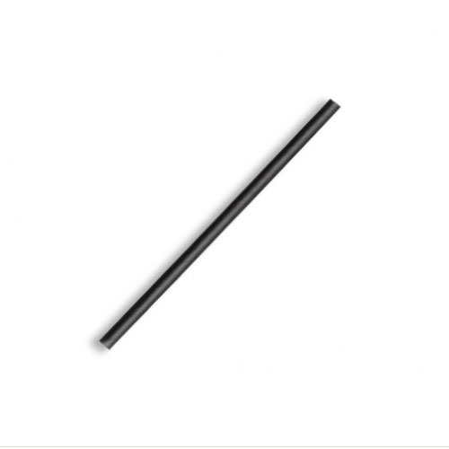
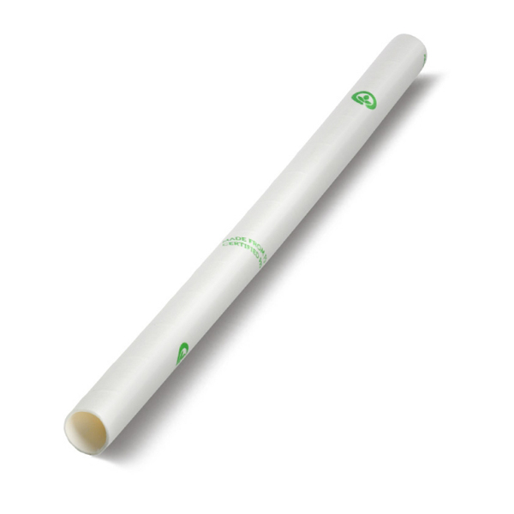

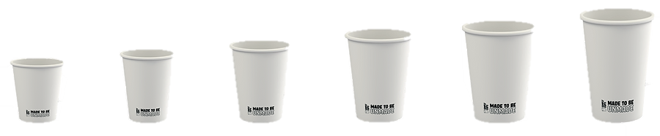
Approved Packaging | Drinks & Accessories
Paper Cups Aqueous Lined Cups with Home Compostable Certification preferred,
Carry Trays Includes Kraft or Paper Pulp Carry Tray
Kraft Coffee Sleeves
Paper Straws No plastic or PLA straws allowed.
RPET #1 Cups & Lids Plastic #5 cups and lids are also acceptable.
Drink containers Plastic Soft Drink Bottles and cans can be sold

Slide 8
Non-Approved
Packaging & Accessories
The following page set out what disposable packaging cannot be used at the National Folk Festival
These products cannot be recycled, composted or upcycled locally, and will end up as waste in landfill.
The Australian Government is phasing out and banning certain hard-to-recycle plastics and single use items. You’ll find these included on the list
Not using these products will reduce waste, improve our recycling initiatives and increase the Festival’s sustainability and landfill diversion goals.
Alternatives for the products listed can be found in the Approved Packaging List on the prior slides.

Slide 9
Non-Approved Packaging & Accessories
Plastic Cutlery - Banned in the ACT under the Circular Economy Act
Plastic Plates and Bowls - Banned in the ACT under the Circular Economy Act
Plastic Straws and drink stirrers- Banned in the ACT under the Circular Economy Act
Bagasse/ Bamboo/ Sugarcane Packaging -May contain PFA’s Cannot be composted or recycled
Bamboo Cutlery - Please choose uncoated wooden items instead
PLA or Non-Recyclable Plastic Cups
PLA Packaging - This can include paper or cardboard packaging that has a PLA lining

Slide 10
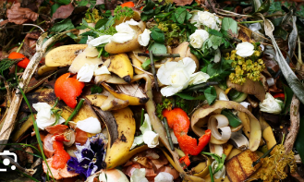
Food Waste
Onsite Organic Waste Stream
This event will have organic
waste bins onsite.
These bins will be able to accept purely
food waste (with no contamination).

Slide 11
What to do with your waste at the NFF
More detailed information will be included in your arrival pack.
The Waste Management Volunteer Team will be available on-site to assist you as needed.
PLACE IN PROVIDED BINS
Paper & Cardboard
Glass
Food Waste & Organics
Aluminium & Steel Cans. Plastic Bottle
Plastic 1’s, 2’s & 5’s
Oil (in provided Oil drums)
All food and beverage packaging in this framework
TAKE THESE ITEMS HOME
(or avoid bringing them)
Polystyrene boxes
Wooden Pallets
Milk Crates
Oil Drums
Treated Timber
Bread crates

